Slide 1
Amazon Product Analytics Dashboard
Power BI Project Report Prepared By: Abhijeet Kedar

Slide 2
Executive Summary
This project analyzes Amazon product ratings, reviews, discounts, pricing, and customer engagement using Power BI dashboards.

Slide 3
Business Objectives
• Understand product performance • Analyze customer engagement • Evaluate pricing and discounts • Generate actionable business insights

Slide 4
Dataset Overview
Key fields includes,
product_id
product_name
Category
discounted_price
actual_price
discount_percentage
Rating
rating_count
about_product
user_id
user_name
review_id
review_title
review_content
img_link
product_link

Slide 5
Data Preparation
• Removed null values • Corrected data types • Split category hierarchy • Created calculated columns and measures • Prepared data model for reporting

Slide 6


KPIs Used
Total Products
Total Review
Average Rating
Average Discount
Avg Actual Price
Average Discounted Price
Total Engagement
Revenue Proxy

Slide 7
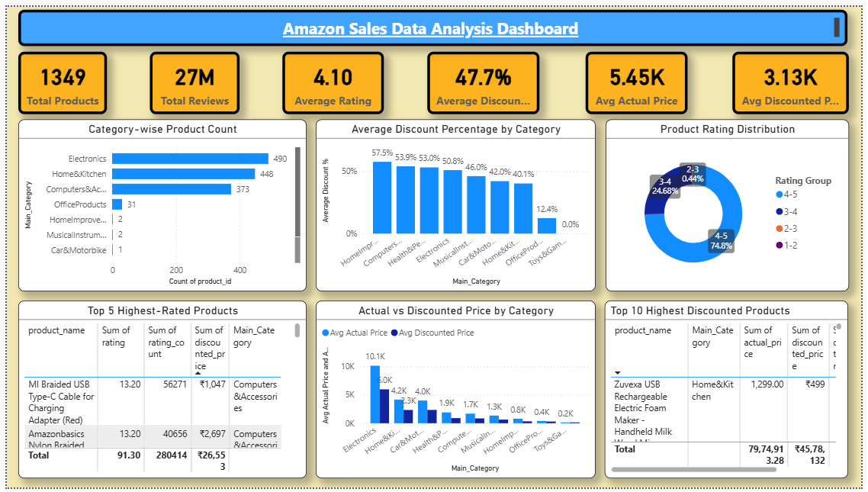
Basic Dashboard
PASTE POWER BI DASHBOARD SCREENSHOT HERE

Slide 8
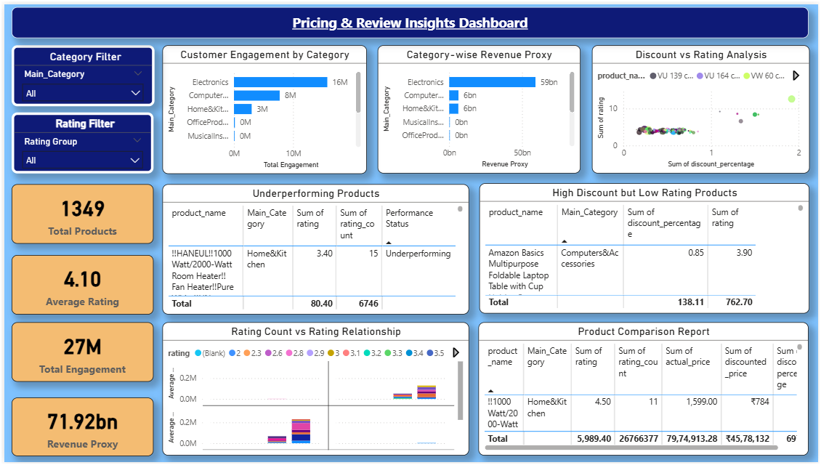
Pricing & Review Insights Dashboard
PASTE POWER BI DASHBOARD SCREENSHOT HERE

Slide 9
Key Insights
• High-rated products attract higher engagement. • A few categories contribute most business value. • Discounts alone do not improve ratings. • Underperforming products require attention.

Slide 10
Recommendations
• Focus on top-performing categories. • Improve low-rated products. • Optimize discount strategies. • Encourage customer reviews and feedback.

Slide 11
Conclusion
Customer engagement, ratings, and pricing significantly influence product performance. Data-driven decisions can improve product visibility and business outcomes.

